Slide 1

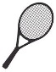







What you need to know
For further information on any of these topics please see our website
Equipment
You are welcome to borrow a tennis racket but we encourage all students who want to continue their tennis to have their own racket so they can practice outside of lessons times. Junior Rackets can be purchased for $40 and our coaches will make sure you get the right size for your child. We also sell a large range of adult and performance rackets.
Lesson Plans
Our lesson plans are designed to progress players through the stages of tennis development so they can advance on their player pathway (see page 3).
All lesson plans and attendance records are digital so you may see our coaches looking at their phones during lessons at times. Formal assessments on players progress and areas to focus on can be arranged
(see page 4).
Communication
Join our Facebook/Instagram page to see regular updates, great tennis related content, and a wide variety of activities kids can do at home.
We are always looking for feedback on how we are doing so please give Ben a call on 0401 887 290 or email info@parksidetennis.com.au
if you have any feedback.
Clubhouse
Our clubhouse is open during class time for our students and their families to enjoy.
You can make yourself a tea/ coffee, read the paper, and use the toys and books to keep younger siblings entertained - particularly useful in the winter months!
Match Play
We run social tennis competitions on Friday night for all junior levels which gives players a chance to practice what they learn in lessons.
Players who attend comp improve much quicker than those that just attend lessons.
The term fee is discounted for students and includes medals and end of term parties. Let us know if you would like to join
Wet Weather
We will let you know as soon as possible if lessons will be cancelled. This is either by e-mail or by text if the class is due to start within 2 hours. Assume lessons are on unless you hear from us. Each term is 9 weeks long to enable a make up lesson in week 10, if needed. Make-up lessons will be confirmed via e-mail.
Re-billing
We automatically deduct term payments 2 weeks prior to the new term commencing to confirm numbers and allocate coaches.
We will send out reminder emails before re-billing. If you are not continuing tennis please opt-out via your customer portal prior to week 10 of term.
Culture
We aim for an inclusive, family friendly culture and offer a free social competition for Lift-off players to encourage kids and parents to socialise outside lessons.
We hope to see you around the club for a chat.

Slide 2
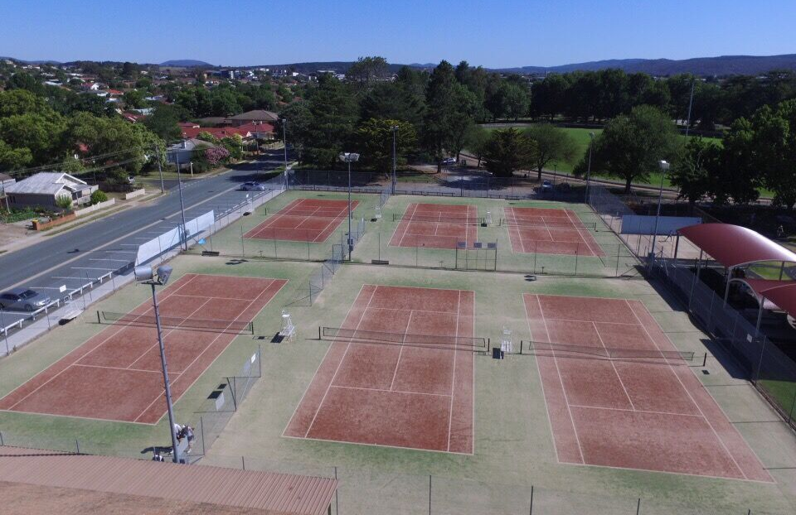
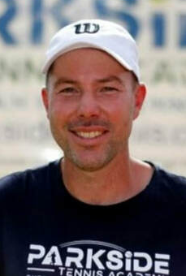
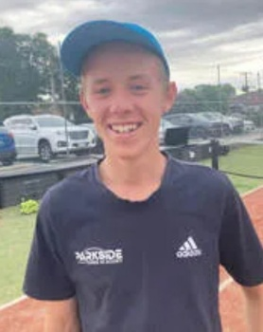
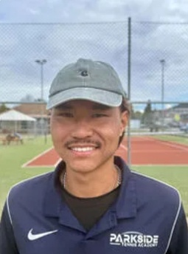
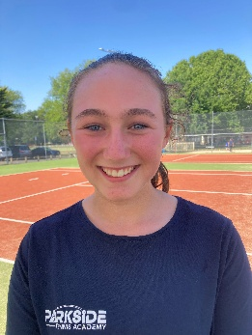
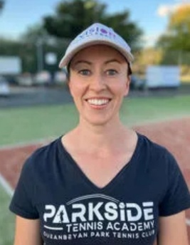
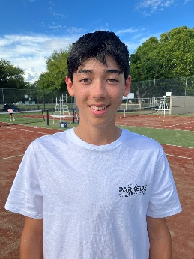
Location and Coaches
For further information on our location and coaches please see our website
Our classes are run at our main centre located opposite 95 Campbell Street and the Brad Haddin Oval.
Please note, we also have our Pickleball courts at Waniassa Street (opposite McDonalds) which are used for our Friday night Red Ball Rally competition.
There is plenty of free parking along Campbell Street and at the carpark between the courts and Brad Haddin Oval. Please enter the courts via the back gate and speak to the Head Coach, who will be located on Court 6, to be directed to your class.
If you need to borrow a racket please let one of our coaches know and they will find the right size for you.
Brad Haddin Oval
Campbell Street
6
5
4
1
2
3
Clubhouse
Meet some of our Coaches
Ben
Josh
Luigi
Bridie
Liam
Kimarny
FUN
FACT
Coach and Owner
Has played tennis for 24 hours straight
Head Coach
Original Parkside Tennis Academy Student!
Head Coach
Has coached internationally and speaks 4 languages
Division 1 Junior Pennant player who kept playing after breaking her wrist
Division 1 Junior Pennant player who is ambidextrous
Coach and Owner
Loves Cardio Tennis and seeing players improve

Slide 3
Tennis Player Pathways
For further information on our programs please see our website
We have a variety of programs to suit both recreational and competitive players. The diagram below shows the pathways available.
Our Matchplay competitions are run weekly to give players the experience of playing tennis matches in a fun social environment. If you would like to join our Matchplay competition please e-mail info@parksidetennis.com.au
Player Pathways
Squad Training
Other programs
Private lessons
Hot Shots Coaching
Hot Shots
Match Play
Colourball League
Pennant Competition
Tournaments
Explore
Blue Stage Approximately 2-5 years
Fundemental Perception Motor skills (FPMS)
Liftoff
Red Stage
Approximately 5-8 years
Red ball
Coaching
Red Ball Match play
Red Ball Squad
Red Ball League
Activate
Orange Stage
Approximately 8-10 years
Private lessons available for all levels
Orange Ball Coaching
Orange Ball Match play
Orange Ball Squad
Orange Ball League
Evolve
Green Stage
Approximately 9+ years
Green Ball Coaching
Green Ball Squad
Green Ball League
Junior Pennant
Super 10s
Green Ball Match play
JDS
Rise
Approximately 10+ years
Yellow Ball Coaching
Yellow Ball League
Junior Pennant
JDS
Yellow Ball Match play
Yellow Ball Squad
JT
Adult
Pennant
AMT
Cardio Play
Recreational Players
Recreational and Advanced Players
Advanced Players

Slide 4
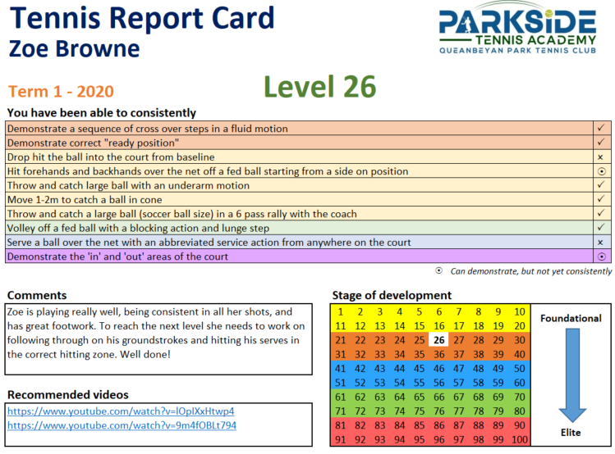
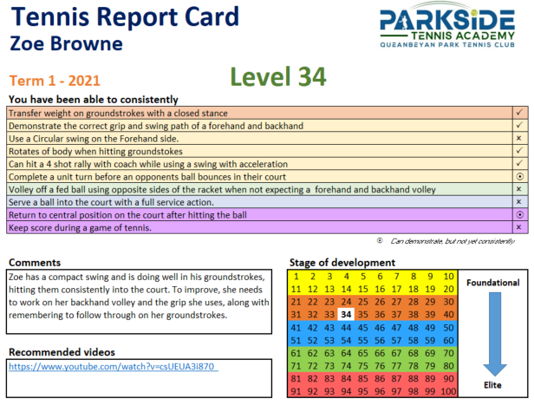
Formal assessments
Formal assessment of students progress and areas for development
If desired, our coaches can undertake a formal assessment of each student against 10 key tennis competencies required to move up to the next level. The formal assessment will include a report card which includes videos of exercises they can practice at home to improve their tennis ability. Our report card system is designed to give players and coaches more information on their tennis progress and what they most need to work on at their current level. If you would like to book a formal assessment please e-mail info@parksidetennis.com.au.

